Slide 1
What You Will Learn Today
What a VCS is
Why using a VCS is a good idea
Why Git is becoming, if not already, the standard VCS of choice for developers worldwide
Why you should care
Git basics, including:
How to obtain & install git
How to use it for basic, common operations
Where to go for more information

Slide 2
VERSION CONTROL SYSTEMS
A way to keep track of changes to files (& folders)
Between multiple authors (developers)
A record of who did what, when
Why is provided by commit messages!
Non-distributed (Subversion, CVS)
Server has the master repo, all commits go to the server
Distributed (Git, Mercurial)
Server has the master repo, but you have a copy (clone) of the repo on your machine
CVS, Visual Source Safe, Perforce are some others

Slide 3
Why version control?
A complete long-term change history of every file.
Branching and merging
Traceability

Slide 4
Why Git?
Distributed Version Control System
An open source VCS designed for speed and efficiency
Created by Linus Torvalds (for managing Linux kernel)
Your best insurance policy against:
Accidental mistakes like deleting work
Remembering what you changed, when, why
Your hard drive blowing up*
Performance
Security
Hashing algorithm called SHA1

Slide 5
Flexibility
Operations that affect branches and tags (such as merging or reverting) are also stored as part of the change history.
Best competitor
Mercurial
Same concepts, slightly simpler to use
Much less popular than Git

Slide 6
Git Clients
Tortoise git,
Gitbash,
Source tree
Repository
BitBucket
Github
Gitlab

Slide 7
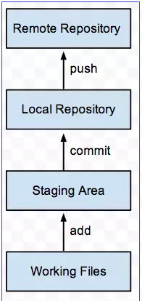
Git Terms

Slide 8
Understanding Git Workflow
Obtain a repository
Either via git init, or git clone, or if you already have the repo, pull changes!
Make some edits
Use your favorite text editor or source code IDE
Most IDEs have Git integration, including NetBeans
git tracks changes to binary files too: images, pdf, etc.
Less useful though, than text-based files
Stage your changes
using git add
Commit your work
git commit -m "Always write clear commit messages!"
Push to remote
git push remotename localbranch:remotebranch

Slide 9
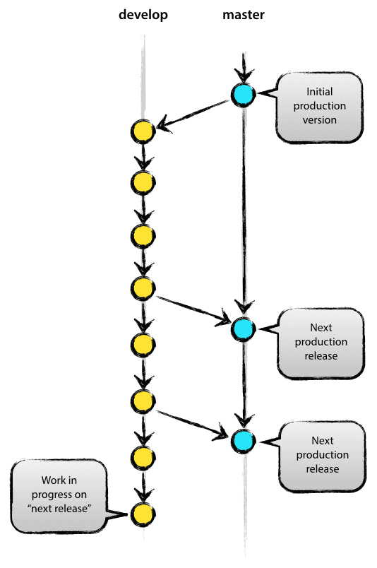
Main Branches
1.Develop
2.master

Slide 10
Source Tree
https://www.sourcetreeapp.com/
Atlassian Product
Perfect for Newbies
GitFlow integration

Slide 11
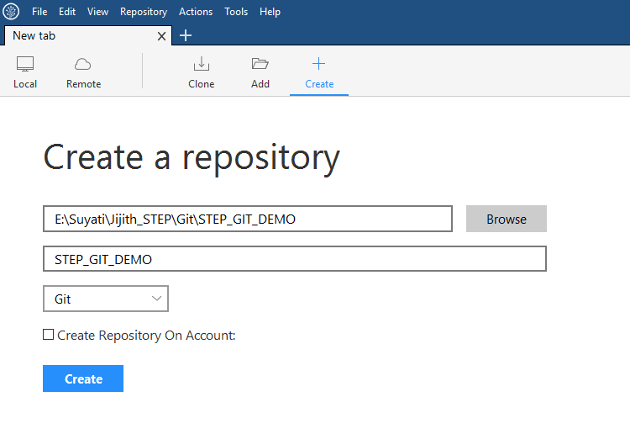
Initialise repository
First of all we have to initialise our repository with this git flow. Before initializing the repository will look like as in figure in sourcetree(client app for version control).

Slide 12
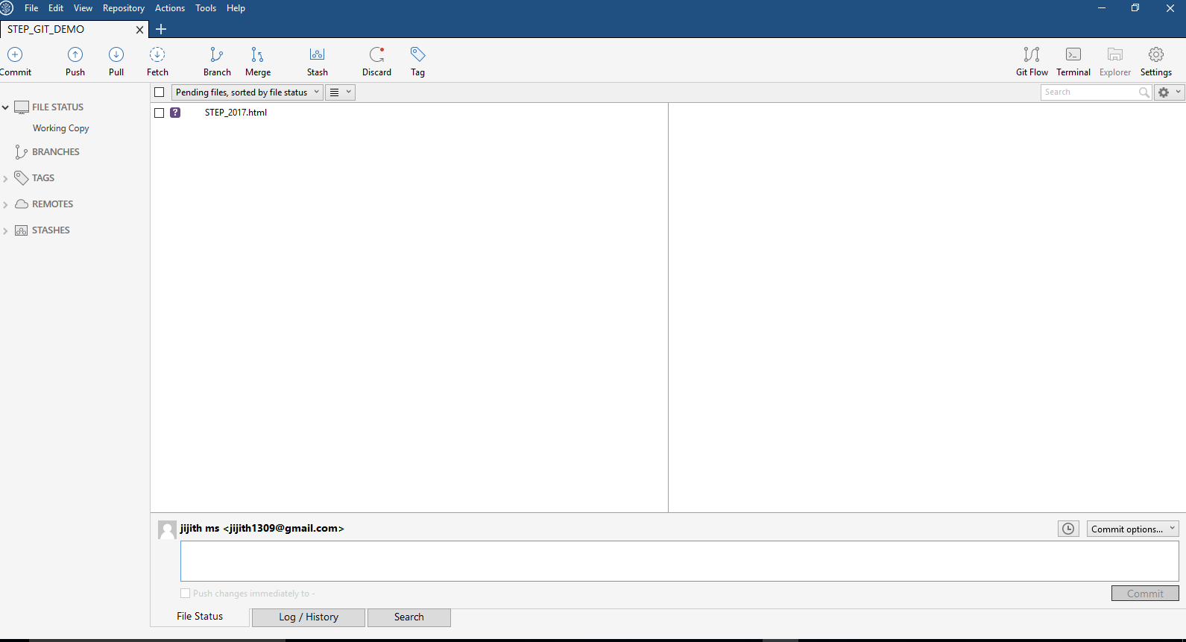
Add files and folders

Slide 13
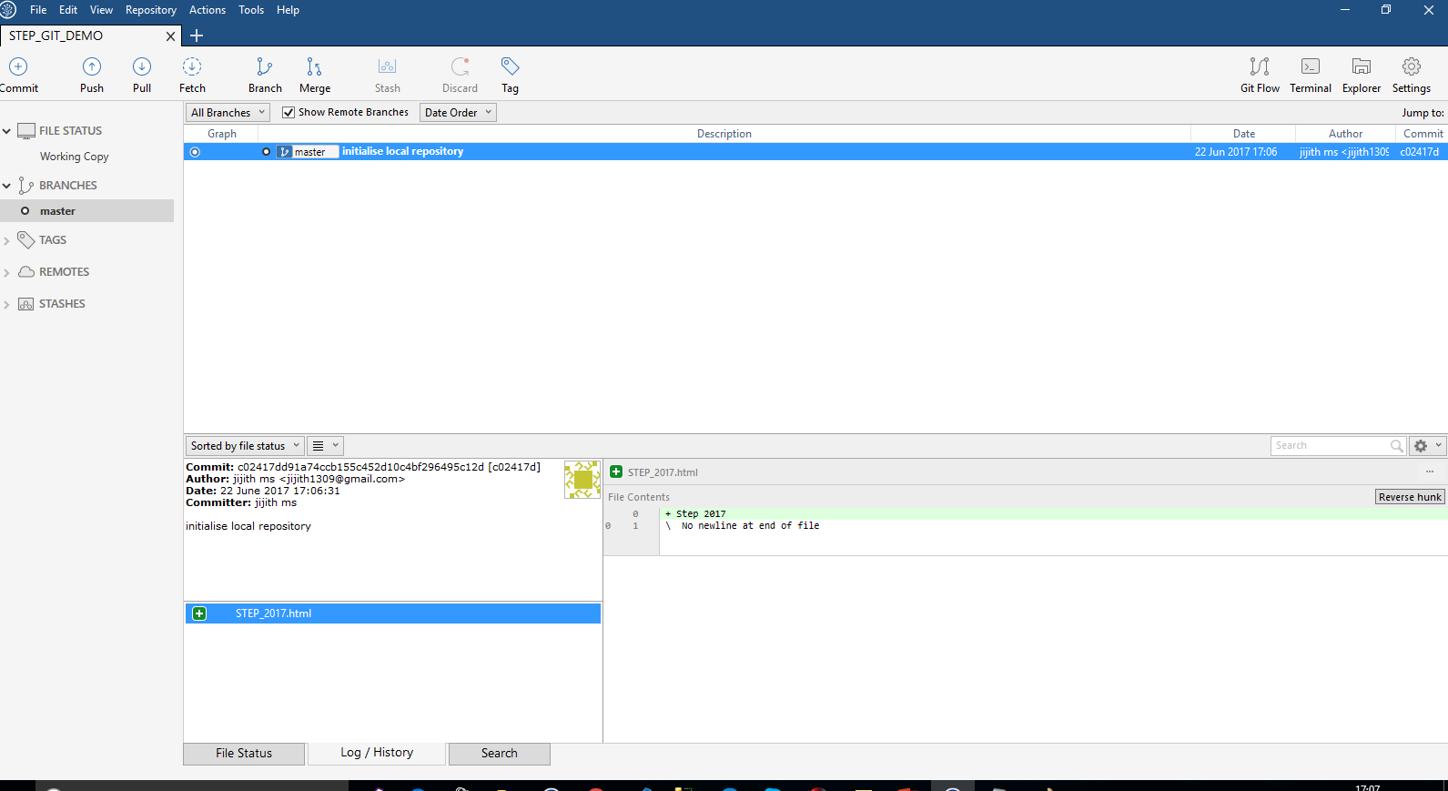

Slide 14
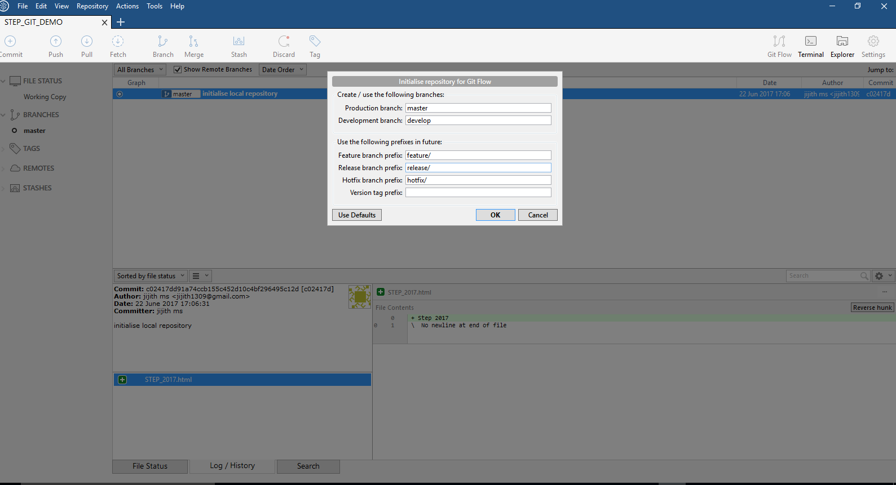
Branch Naming
Feature
Anything except master, develop, release-*, hotfix-*
Release Release-*
Hotfix Hotfix-*
Tag

Slide 15
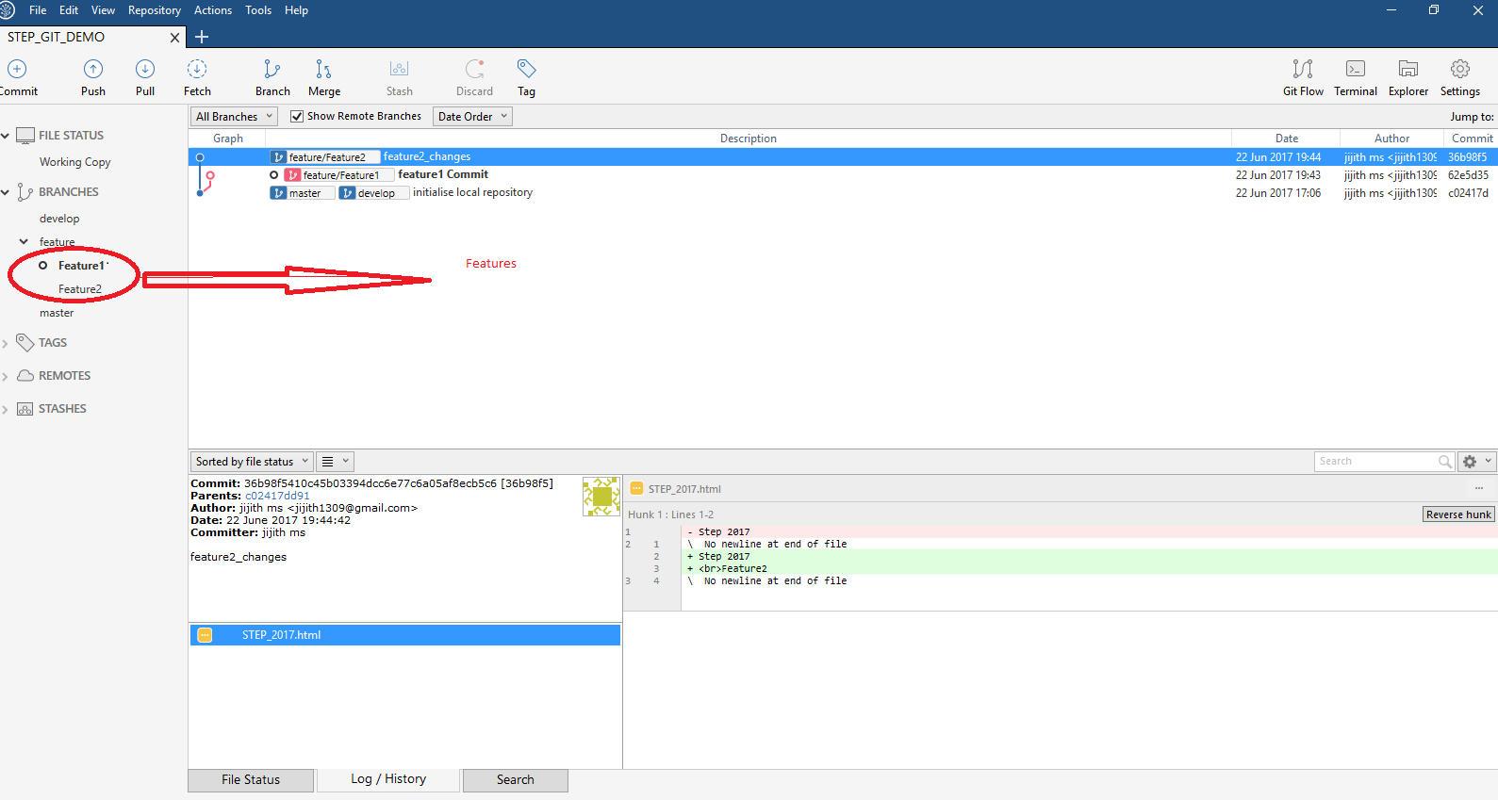

Slide 16
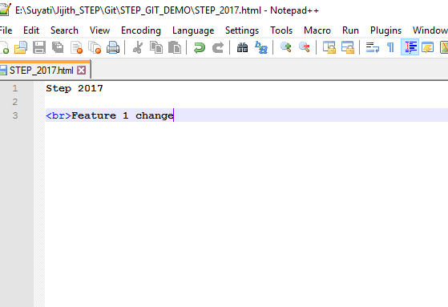
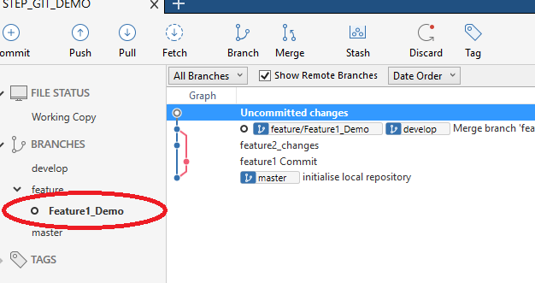

Slide 17
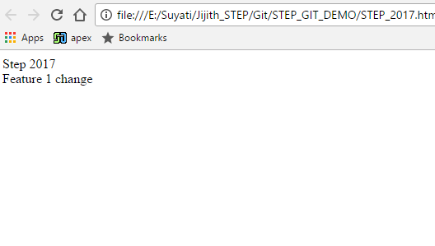

Slide 18
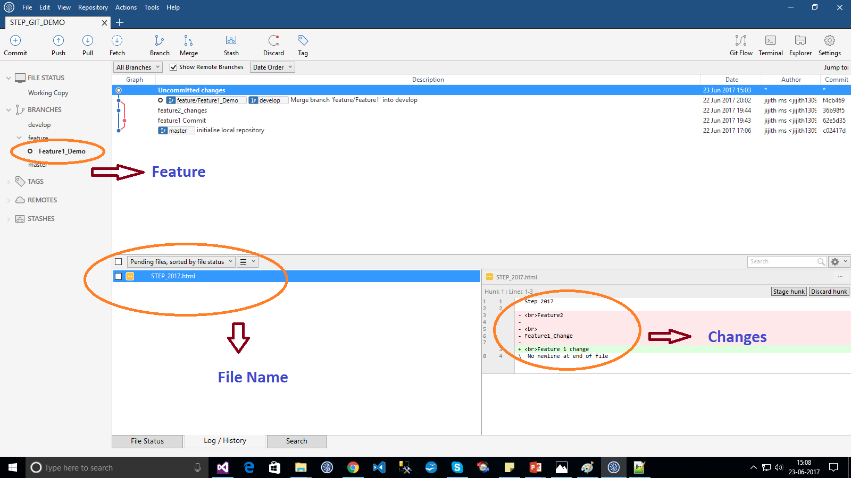

Slide 19
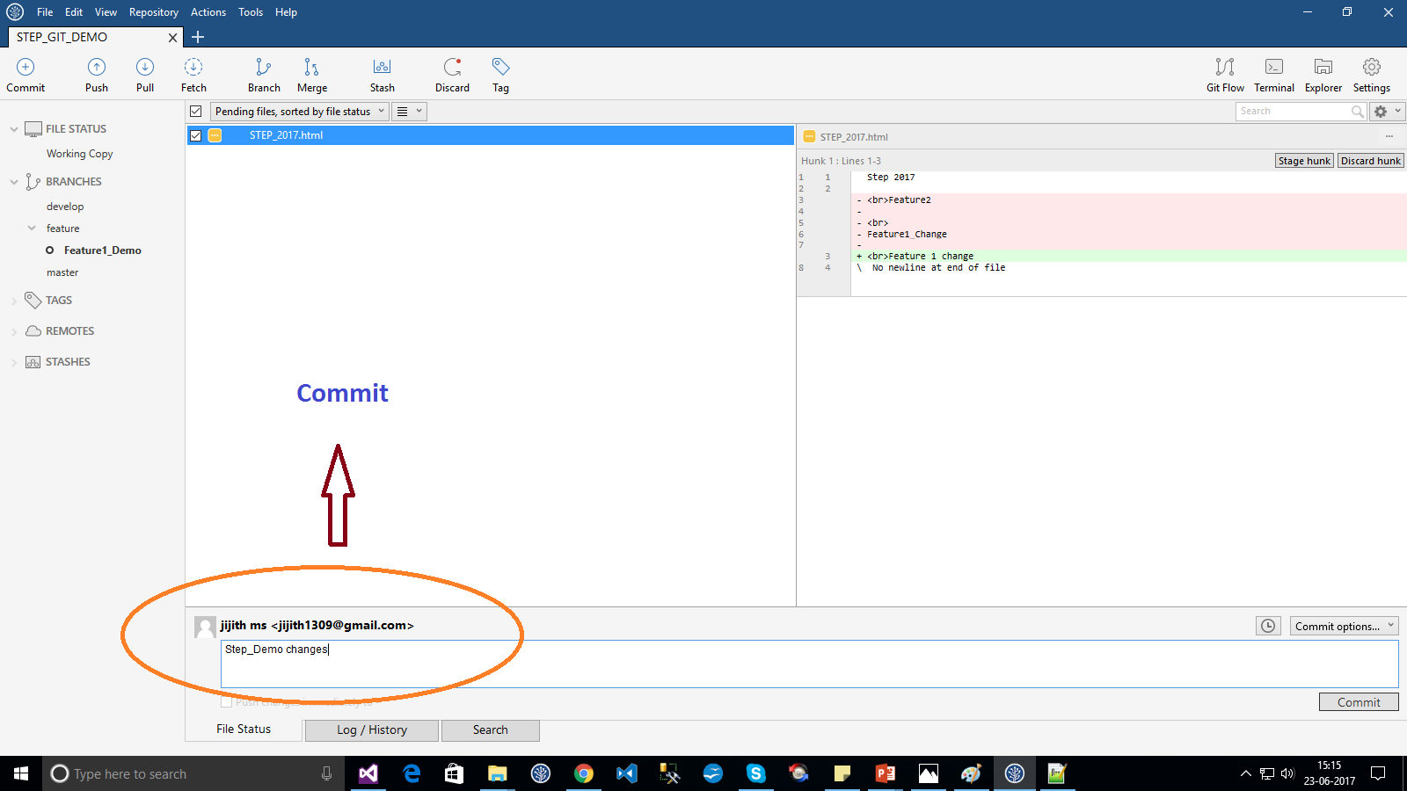

Slide 20
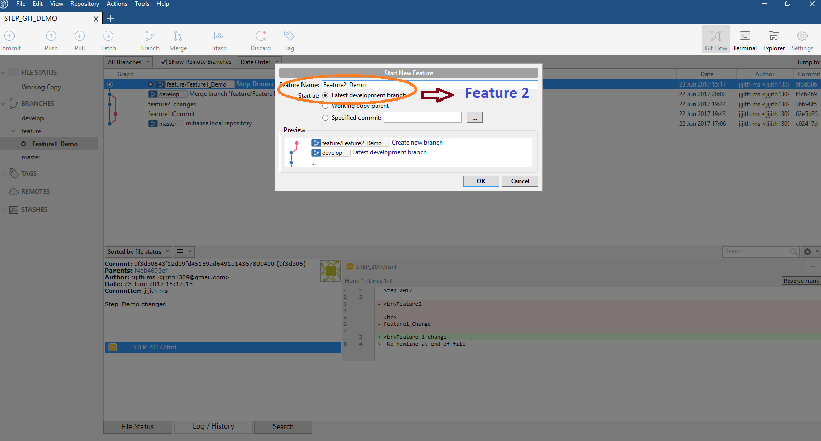

Slide 21
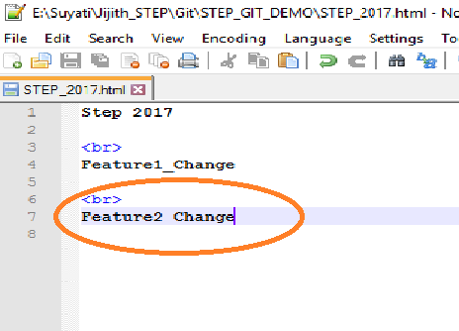
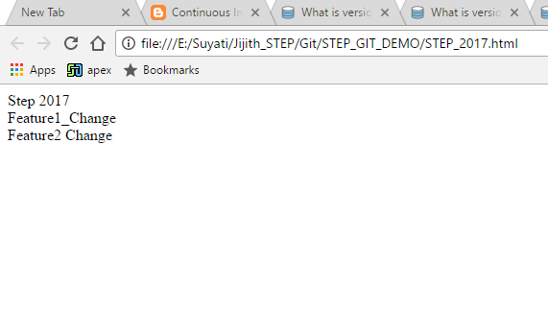

Slide 22
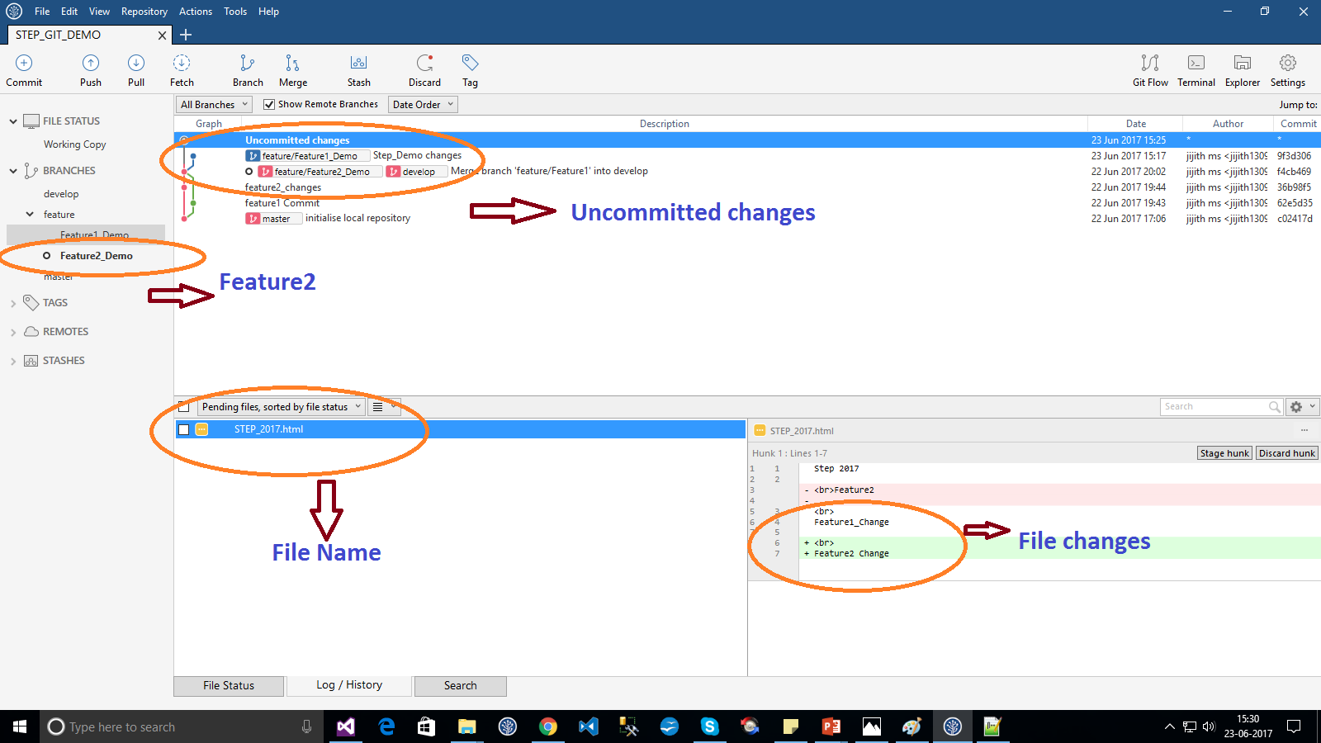

Slide 23
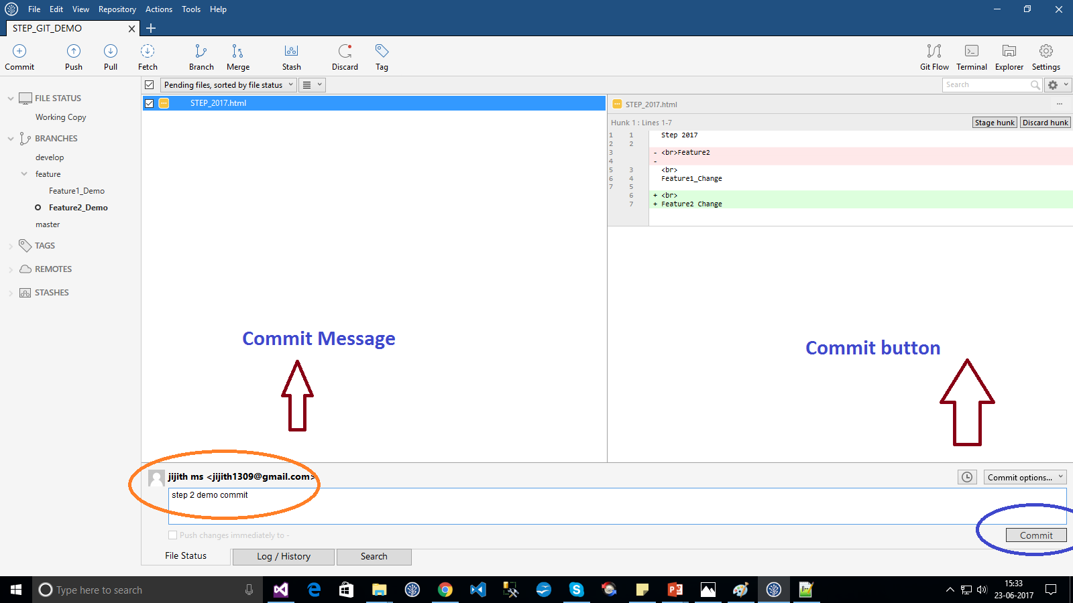

Slide 24
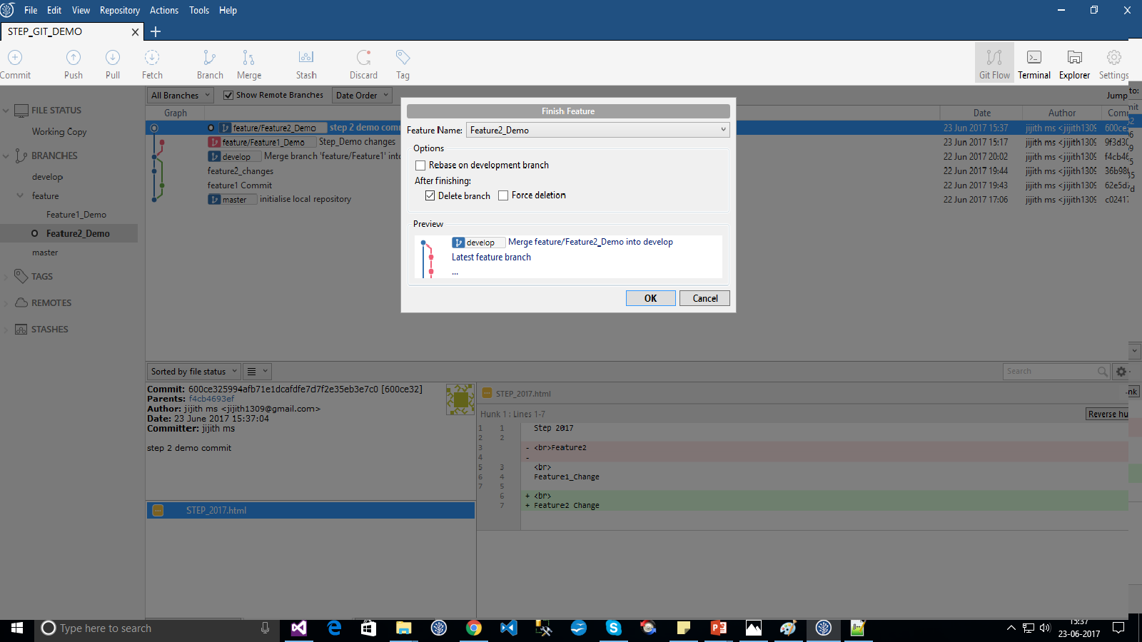

Slide 25
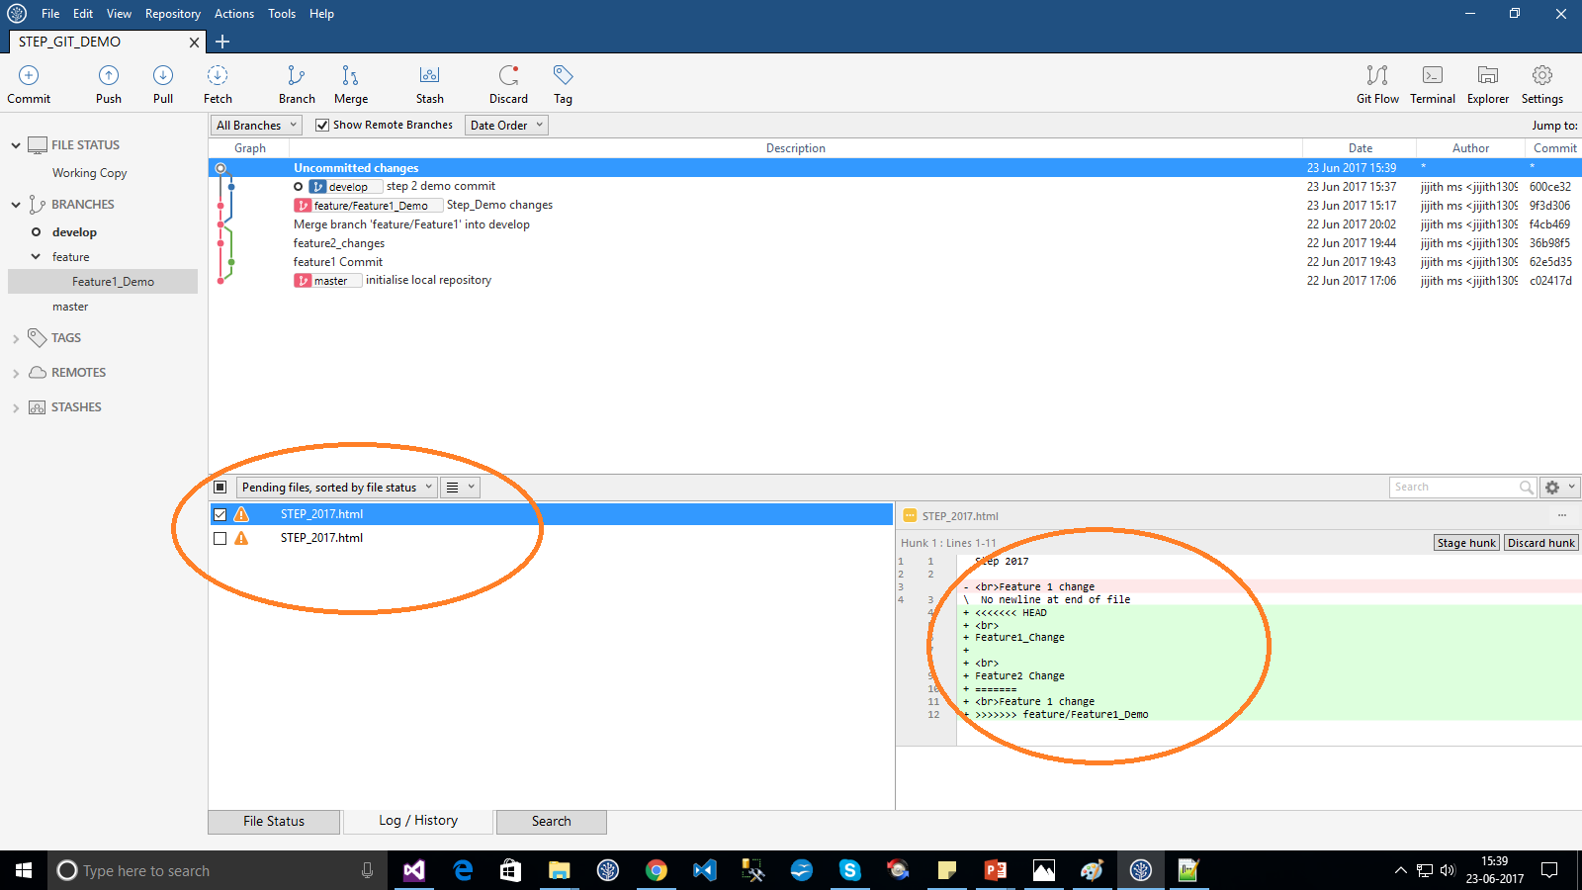

Slide 26
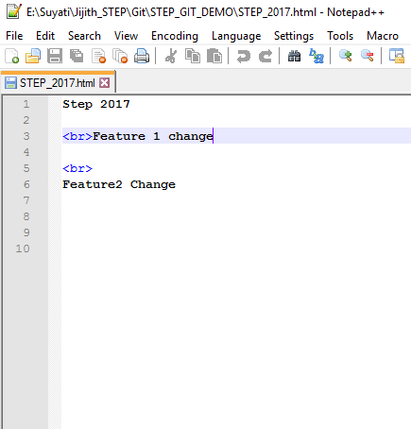
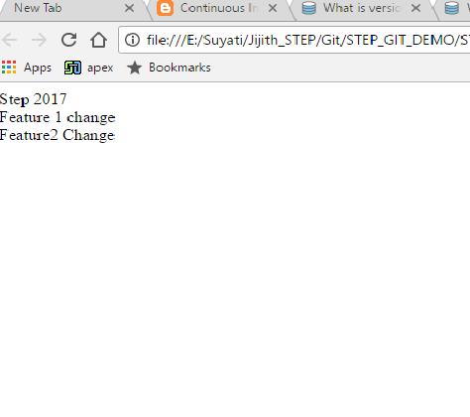

Slide 27
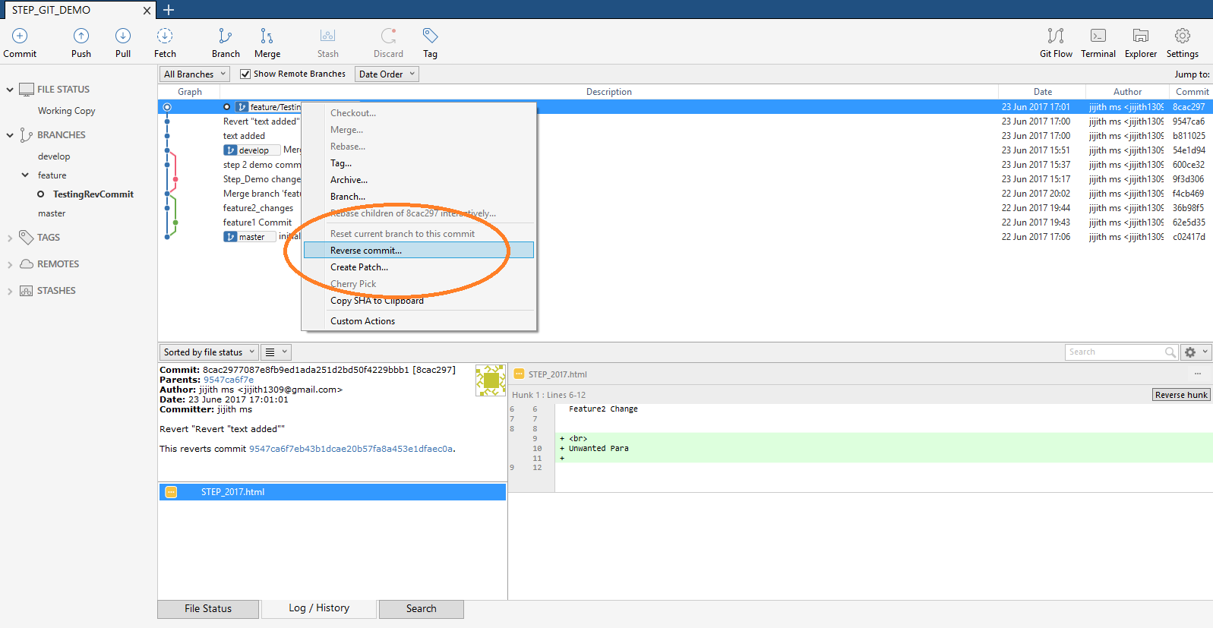
Reverse Commit

Slide 28
Gitlab
Opensource Git server like GitHub
Activity Stream
File browser
Integrated wiki
Powerful Code review workflow
Issue Management
Code snippets
Alternatives are Sourcetree,Github

Slide 29
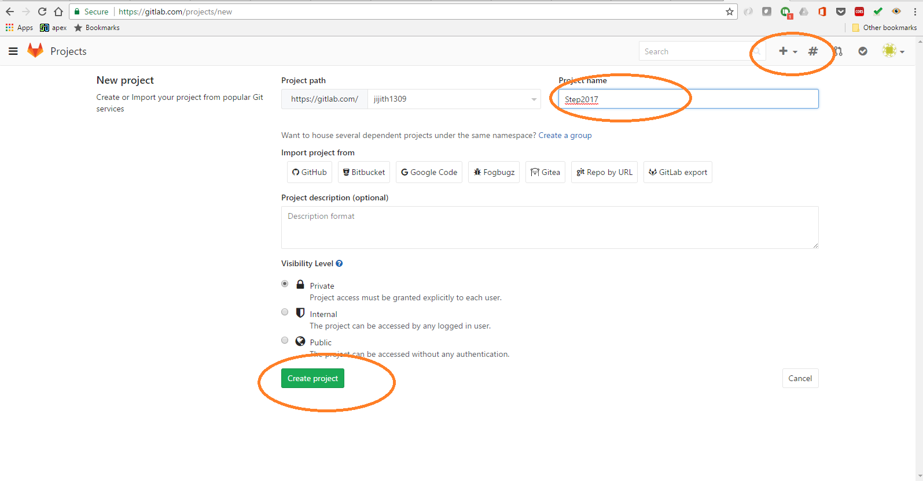

Slide 30
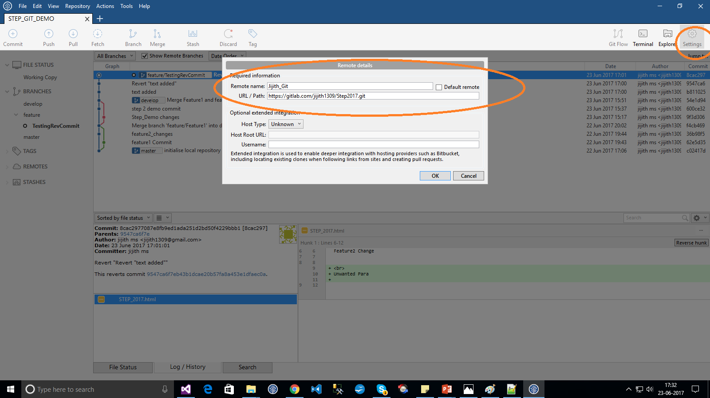

Slide 31
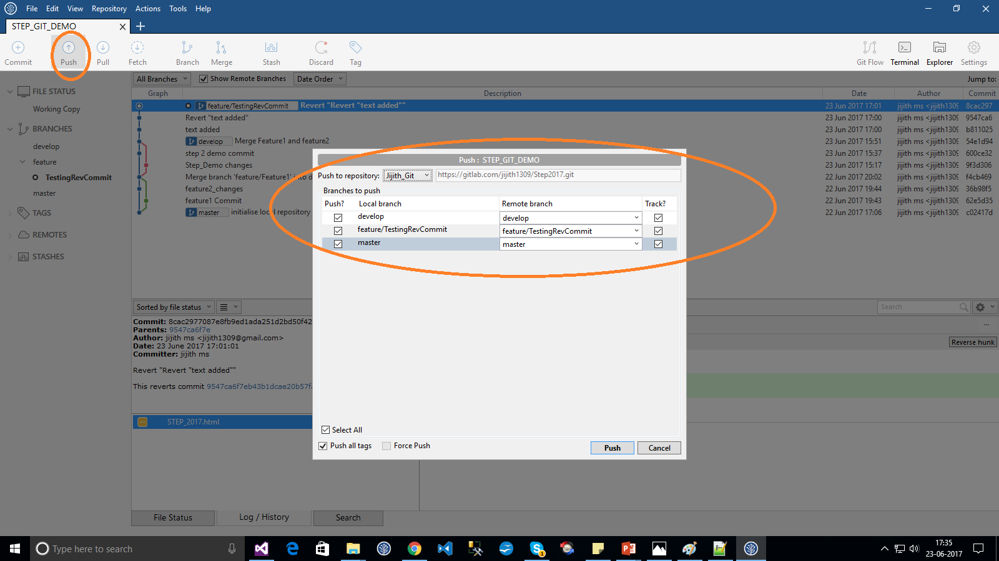

Slide 32
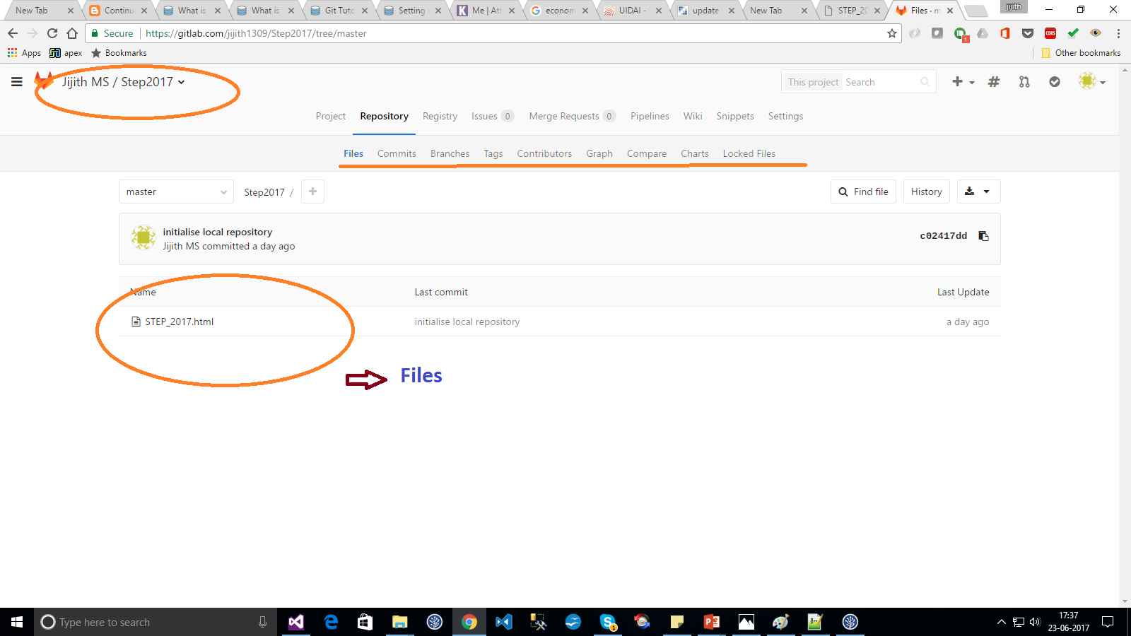

Slide 33
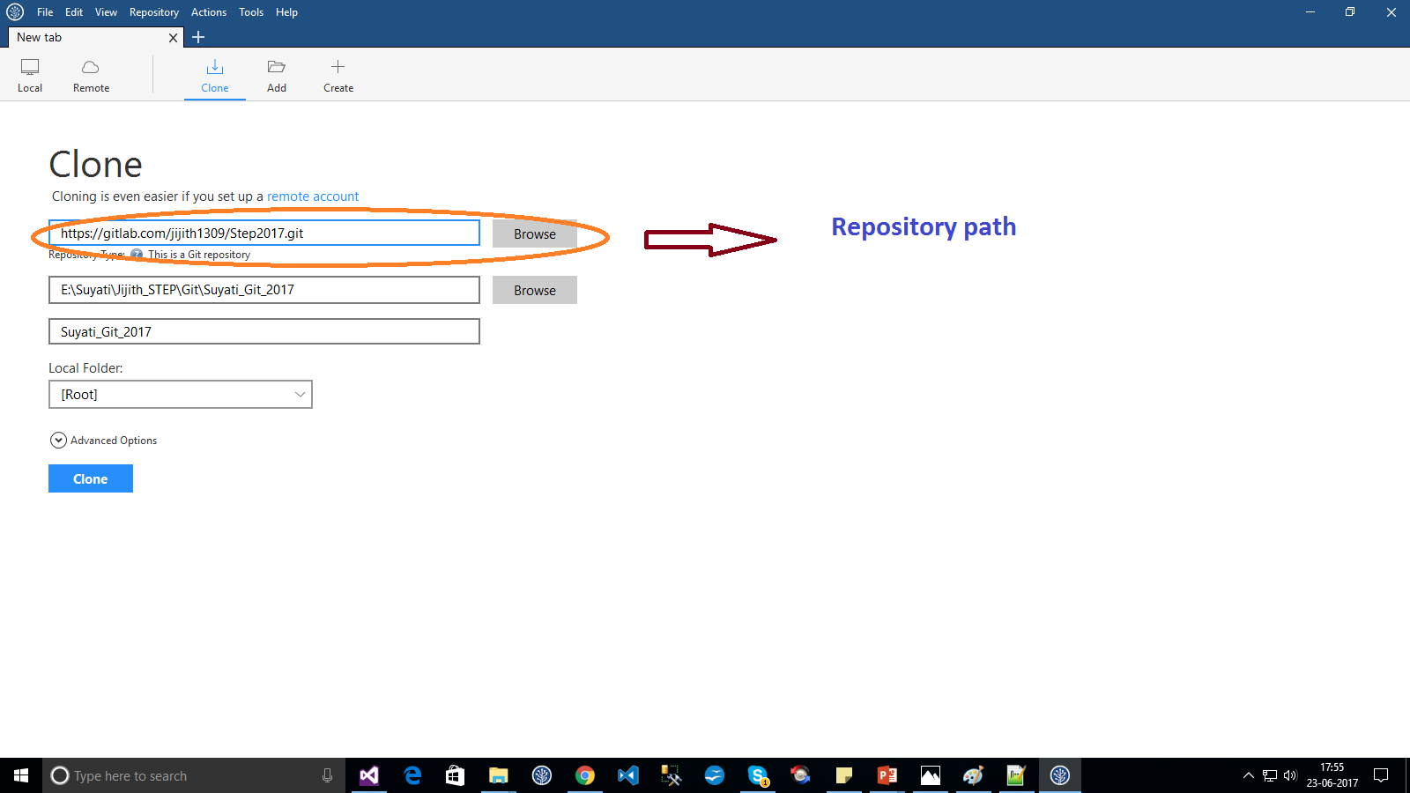
Remote Repository
Clone

Slide 34
Summary
We covered fundamentals of Git
Three trees of git
HEAD, INDEX and working directory
Basic work flow
Modify, stage and commit cycle
Branching and merging
Branch and merge
Remote
Add remote, push, pull, fetch
Other commands
Revert change, history view

